Slide 1

Introduction to Expert Systems
Dr. Hatem Magdy

Slide 2
Knowledge
Representation – SN – Frames

Slide 3
Example: Birds
%%% Semantic net knowledge about animals.
%%%%%%%%%%%%%%%%%%%%%%%%%%%%%%%%%%%%%%%%%%%%%%%
canary -- is_a --> bird. canary -- can --> sing. canary -- is --> yellow.
ostrich -- is_a --> bird. ostrich -- not(can) --> fly. ostrich -- is --> tall.
bird -- is_a --> animal. bird -- can --> fly. bird -- has --> wings.
bird -- has --> feathers.
fish -- is_a --> animal.
animal -- can --> breathe. animal -- has --> skin. animal -- can --> move.

Slide 4
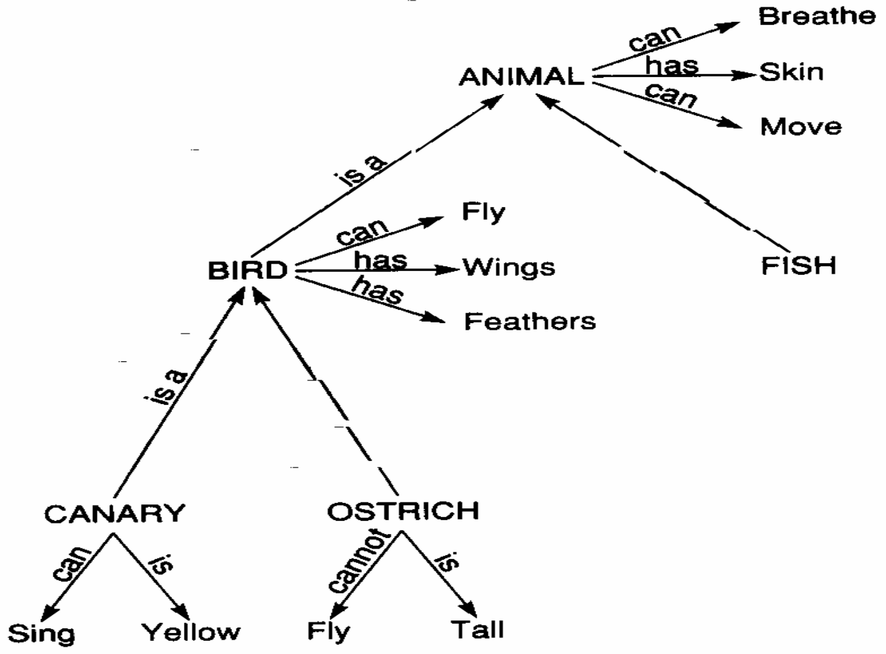
Semantic Nets (SN) & inheritance
SN can be used for data retrieval, also it can provide for deduction
using inheritance
Since a canary is a bird, it inherits the properties of birds (likewise, animals)
e.g., canary can fly, has skin, …

Slide 5

Semantic nets in Prolog
Can define nodes (concepts/objects) as Prolog terms
Can define arcs using operators '--' and '-->' (using not for negative relations)
%%% Semantic net knowledge about animals.
%%%%%%%%%%%%%%%%%%%%%%%%%%%%%%%%%%%%%%%%%%%%%%%
canary -- is_a --> bird. canary -- can --> sing. canary -- is --> yellow.
ostrich -- is_a --> bird. ostrich -- not(can) --> fly. ostrich -- is --> tall.
bird -- is_a --> animal. bird -- can --> fly. bird -- has --> wings.
bird -- has --> feathers.
fish -- is_a --> animal.
animal -- can --> breathe. animal -- has --> skin. animal -- can --> move.

Slide 6
Practical Example:
“John gives Mary a book”
Give
Book
instance
instance
John
agent
g
object
b
beneficiary
give(John, Mary, book)
Mary

Slide 7
Practical Example:
Mammal
isa
Person
has-part
Nose
uniform color
instance
Red
Owen
team
Liverpool
person(Owen) ≡ instance(Owen, Person) team(Owen, Liverpool)

Slide 8
Example:
Taller than
John
Bill
height
height
H1
greater-than
H2
value
1.80

Slide 9
Hussin
Example: Birds
Aly
AOK: A Kind Of
is-boss-of
Ramy
is-boss-of
is-a
is-friend-of
is-a
is-a
buys-from
is-a
fights-with
is-a
Man
Saeed
AKO
Dog
Nader
is-a
lives-with
takes-care-of
sells-to
Human
barks
is-a
Zead
Fluffy

Slide 10
Frames (F’s)

Slide 11
Overview of Frame Structure
Two basic elements: slots and facets (fillers, values, etc.);
Typically have parent and offspring slots: used to establish a property inheritance hierarchy (e.g., specialization-of)
Descriptive slots: contain declarative information or data (static knowledge)
Procedural attachments: contain functions which can direct the reasoning process (dynamic knowledge)
(e.g., "activate a certain rule if a value exceeds a given level")
data-driven, event-driven ( bottom-up reasoning) expectation-drive or top-down reasoning
pointers to related frames/scripts - can be used to transfer control to a more appropriate frame

Slide 12
Slots
Each slot contains one or more facets; facets may take the following forms:
Values
Default: used if there is not other value present
Range: what kind of information can appear in the slot
if-added: procedural attachment which specifies an action to be taken when a value in the slot is added or modified (data-driven, event-driven or bottom-up reasoning)
if-needed: procedural attachment which triggers a procedure which goes out to get information which the slot doesn't have (expectation- driven; top-down reasoning)
Other: may contain frames, rules, semantic networks, or other types of knowledge
[Rogers 1999]

Slide 13
Usage of Frames
after selecting (or instantiating) a frame or script in the current context, the primary process is filling in details called for by the slots of the frame:
can inherit the value directly
can get a default value
these two are relatively inexpensive
can derive information through the attached procedures (or methods) that also take advantage of current context (slot- specific heuristics)
filling in slots also confirms that frame or script is appropriate for this particular situation
[Rogers 1999]

Slide 14
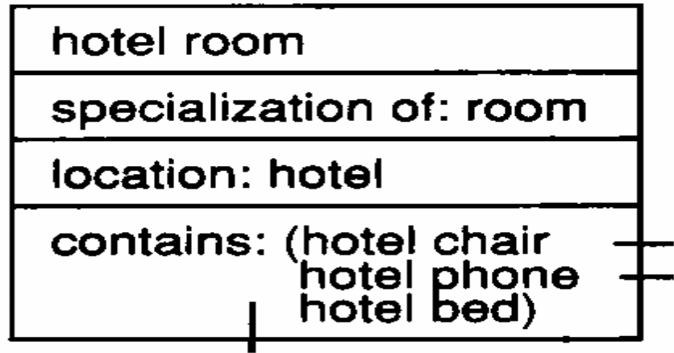
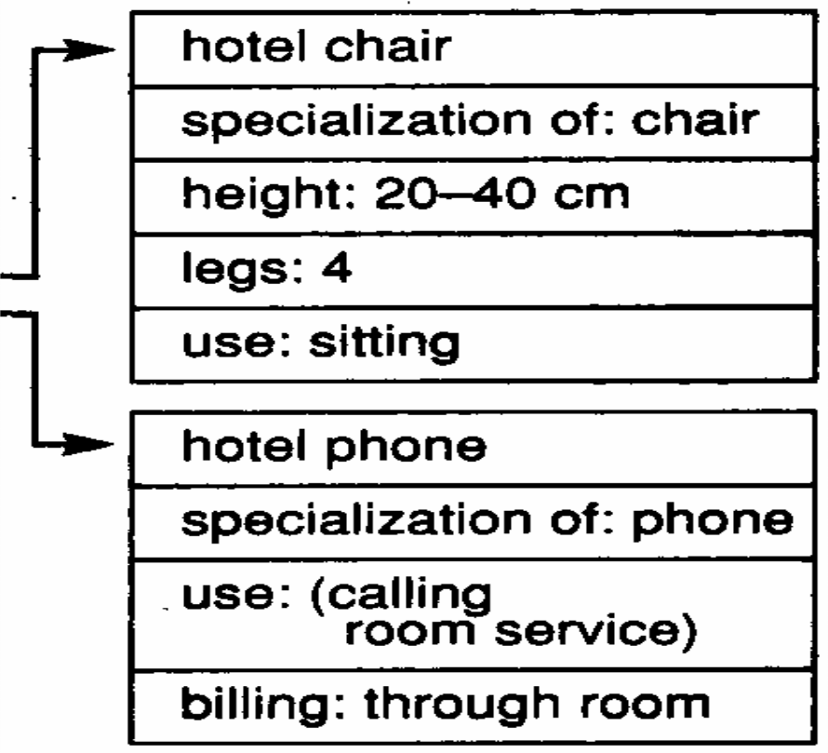
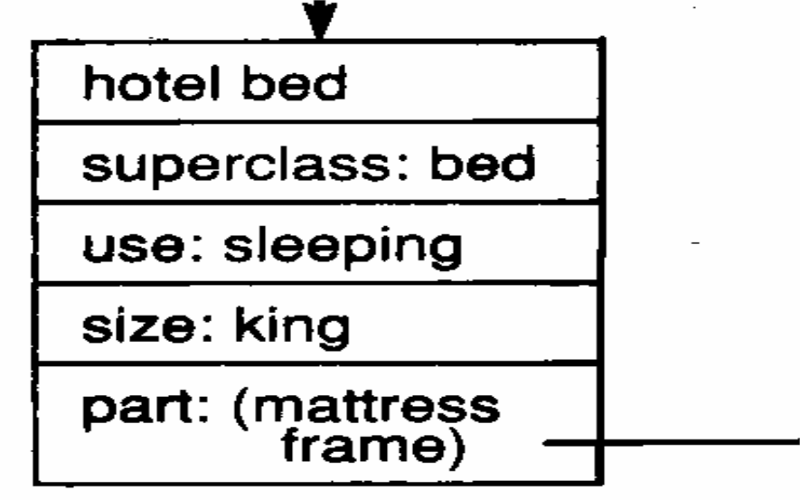
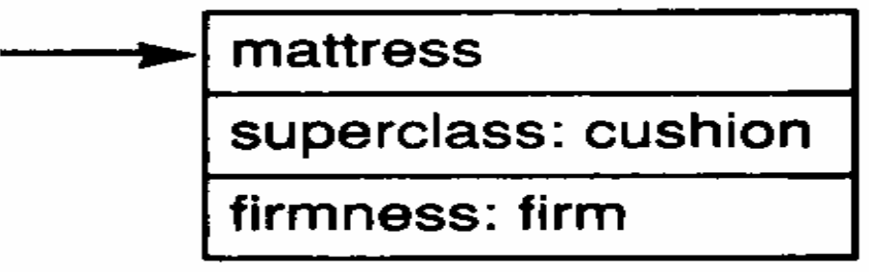
Example: Hotel Room

Slide 15
Frame set in Prolog
%%% Frame knowledge about animals.
%%%%%%%%%%%%%%%%%%%%%%%%%%%%%%%%%%%%%%%%%%%%%%%
canary frame
[is_a :: bird,
can :: sing,
is :: yellow].
ostrich frame
[is_a :: bird,
not(can) :: fly,
is :: tall].
represent a frame as
Name frame
[Slot1 | :: | Filler1,
Slot2 | :: | Filler2,
SlotN | :: | FillerN].
bird frame
[is_a can has has
:: animal,
:: fly,
:: wings,
:: feathers].
again, use not to represent negative relationships
fish frame
[is_a :: animal].
animal frame
[can :: breathe,
has :: skin,
can :: move].

Slide 16
Frame applications
Vision
Minsky saw frames as representing different perspective of an object
as the point of view changes, switch frames
Language understanding
use frames with defaults to "fill in the blanks" in understanding
EXAMPLE: "I looked in the janitor's closet …"
this creates a scene in your imagination with slots & default fillers
Note: frames are general purpose, used in many AI systems
e.g., Lenat's AM represented concepts as frames
when discovering new concepts, new frames were created with new slots
MIT research on frames (and similar research at XEROX PARC) led to object-oriented programming and the OOP approach to software engineering

Slide 17
Frames
Animals
T F
Alive
Flies
isa
Birds
Mammals
2
T
Legs 4
Legs
Flies
isa
Penguins
Cats
Bats
Flies F
2
T
Legs
Flies
instance
Opus
Bill
Pat
Opus
Bill
Pat
Name
Name
Name
Friend
Friend

Slide 18
Example: National Handball Team for Men
height
has
Two eyes
1- Semantic Net
is a
50 ≤
height
female
male
height
≥ 70
is a
height
≥ 190 cm
Equal hand
shooting
Handball Player
National Team for Men
Goal average
≥ 5
is a is a
7 ≤
Goal average
Attacker
Defender
Goal average
≥ 2
instance
instance
club
Gohar
Awad
club
Ahly
Abo Treka
Ahly

Slide 19
Example: National Handball Team for Men
2- Frames
Frame: Handball Player
Shooting: Equal hand Is a: Male
Height: ≥ 190 cm Goal average: ≥ 5
Frame: Attacker
Goal average: ≥ 7
Is a: Handball Player
Frame: Gohar Instance: Attacker Club: Ahly
3- Rules
Rule-1: IF a Handball player THEN his height is ≥ 190 cm
AND he is a male AND his shooting is ……

